Slide 1


C# for Beginners
An Introduction to C#
Kyriacos Kyriacou
kyriakos.kyriakou@studentpartner.com



Slide 2
About
Kyriacos Kyriacou
Microsoft Student Partner
Computer Science Student
Certificate of Attendance (In the end)
+ Surprise for those who attend all 3

Slide 3
Roadmap
Module 1
What is C#
Variables + Constants
Var Keyword
Main Data Types
Arithmetic Operators
Basic Input / output
String Manipulation
Conditional Statements
Arrays / Lists
Loops
Module 2
Object-oriented theory
Classes
Constructor
Method
Field & Property
Access Modifiers
Working with objects
Inheritance
Abstract Classes
Interface
Module 3
Introduction to JSON vs XML
o What is JSON
Consume JSON API
JSON De/Serialization
LINQ & Enumerable
Enumerable Class Methods
Where to go next

Slide 4
What is C#?
General-purpose
Object-oriented
Based on .NET Framework

Slide 5
Variables + Constants
Store Value
Variable’s value may change
Constant’s value is fixed

Slide 6
Main Data Types
Type | Example
int | 2, -18
float, double | 2.4, -18.9
char | 'a', 'B'
bool | true, false
string | "Hello World"

Slide 7
Var Keyword
Within a function’s scope, you can declare a variable using var
The following lines are identical
int i = 10;
var i = 10;

Slide 8
Arithmetic Operators
A = 20
B = 10
Operator | Symbol | Example | Result
Addition | + | A + B | 30
Subtraction | - | A – B | 10
Multiplication | * | A * B | 200
Division | / | A / B | 2
Modulus | % | A % B | 0
Increment | ++ | A++ | 21
Decrement | -- | A-- | 19

Slide 9
Arithmetic Operators (Bonus)
You can combine 5 basic operators (+, -, /, *, %) with assignment operator (=)
Instead of A = A + 5
You can write A += 5

Slide 10
Basic Input / Output
We are using simple Console application
We need to
Get (read) data from user
Show (write) data to user

Slide 11
DEMO

Slide 12
String Manipulation
Declaring Strings with special characters
String Format Template
Formatting Output Value within String
Built-in String Methods + Properties

Slide 13
String Formats
Ready-made (A = 12400)
Some Formats
There are also custom-formats
Name | Format | Example | Result
Currency | c | {A:C} | $12,400
Scientific | e | {A:e} | 1.240000e+004
Comma for thousands | n | {A:N} | 12,400

Slide 14
DEMO

Slide 15
Conditional Statements
If-statement
Relational Operator
Operator | Symbol | Example | Result
Equality (Not Equal) | == != | A == B A != B | false true
Greater Than (+ or Equal) | > >= | A > B A >= B | false false
Less Than (+ or Equal) | < <= | A < B A <= B | true true
A = 5
B = 7

Slide 16
Conditional Statements
Logical Operators
Operator | Symbol | Example | Result
AND | && | A && B | false
OR | || | A || B | true
NOT | ! | !(A && B) | true
A = true
B = false

Slide 17
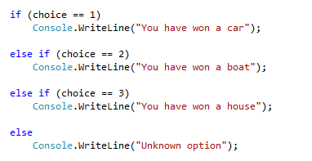
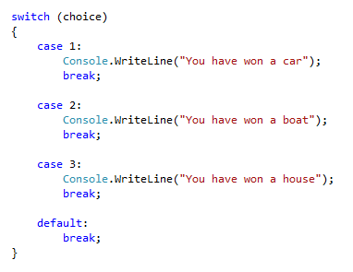
IF & Switch
IF-Statement
Switch

Slide 18
DEMO

Slide 19
Arrays
Set of variables bundled together
9
5

Slide 20
Lists
Like arrays but better
Dynamic (no need to declare size)
A collection with built-in methods and easier to use

Slide 21
DEMO

Slide 22
Loops
Multiple/Continuous Execution
Until a condition is met
For, While, Do While
Foreach
Code
Condition
If condition is true
If condition
is false

Slide 23
DEMO

Slide 24
Summary
What is C#
Variables + Constants
Var Keyword
Main Data Types
Arithmetic Operators
Basic Input / output
String Manipulation
Conditional Statements
Arrays / Lists
Loops

Slide 25

Assignment (Optional)
Create a parking program.
The program has a menu with 4 options
Add Car Number
Asks user to input a number plate. It should not allow user to enter an existing number plate twice & they should be stored in capitals
Remove Number Plate
Remove car number the user enters (if it exists)
Show All Number Plates
Show all the car numbers that exist in the system
Exit

Slide 26
Thank you for your time. Any Questions?

